Slide 1
Game - ColorCatch
By Anish Acharya

Slide 2
Game – ColorCatch
“Color Catch” is a single-player game on the Cross-platform. The player(cube) will progress through levels which require precise manipulation of the environment, though the game Encourages creativity and daring via branching pathways.
The episodic structure of the game facilitates the pace of the story. The player(cube) will increase the score by getting the same colored cube and the cube color also be changing.

Slide 3
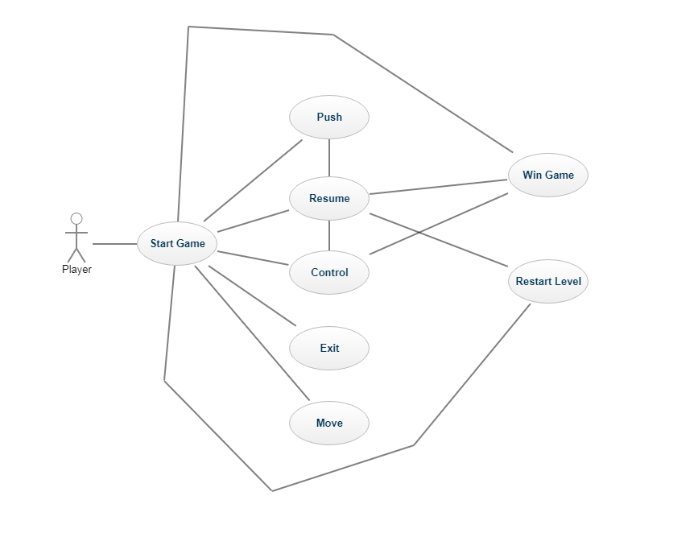
Use case Diagram

Slide 4
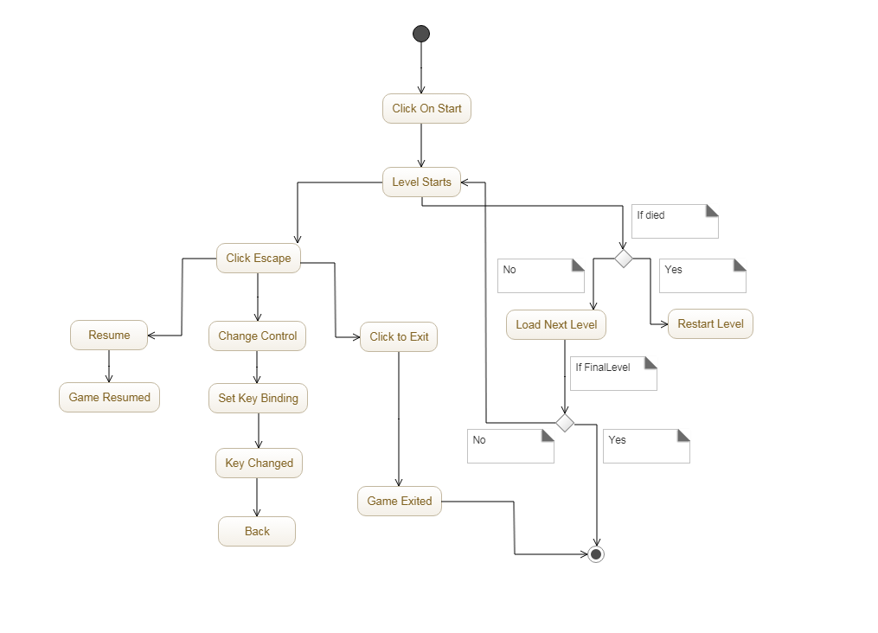
Activity Diagram

Slide 5
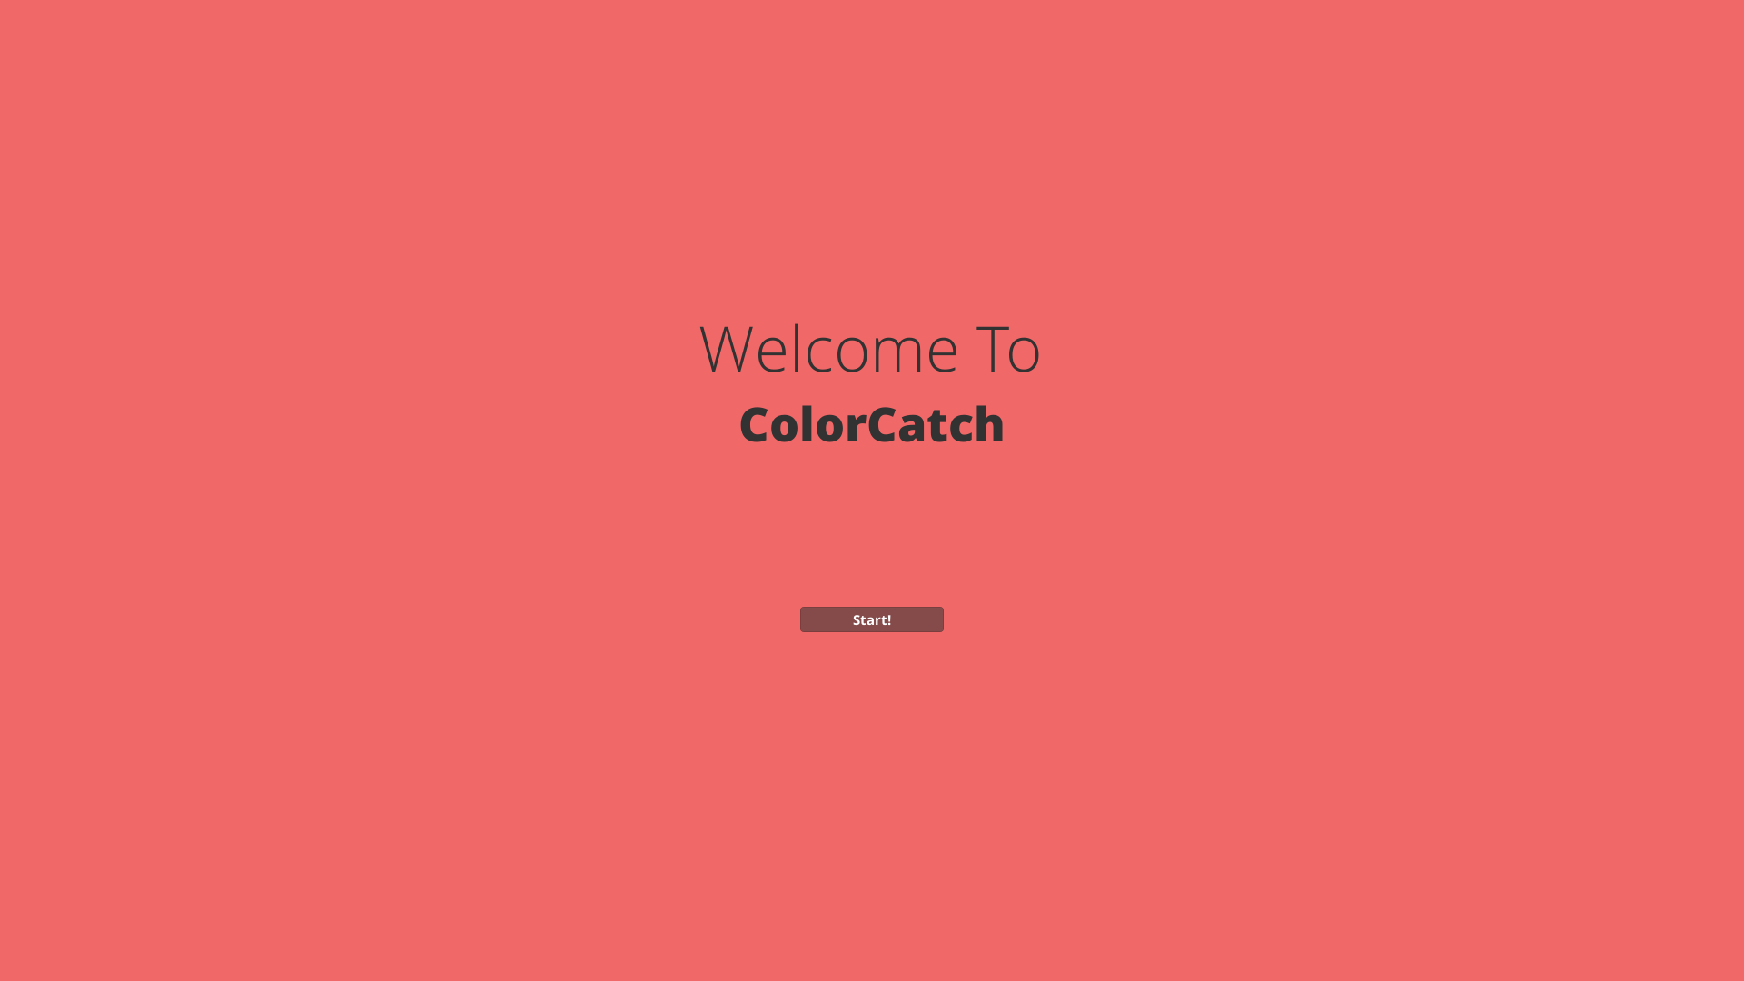
Welcome Screen

Slide 6
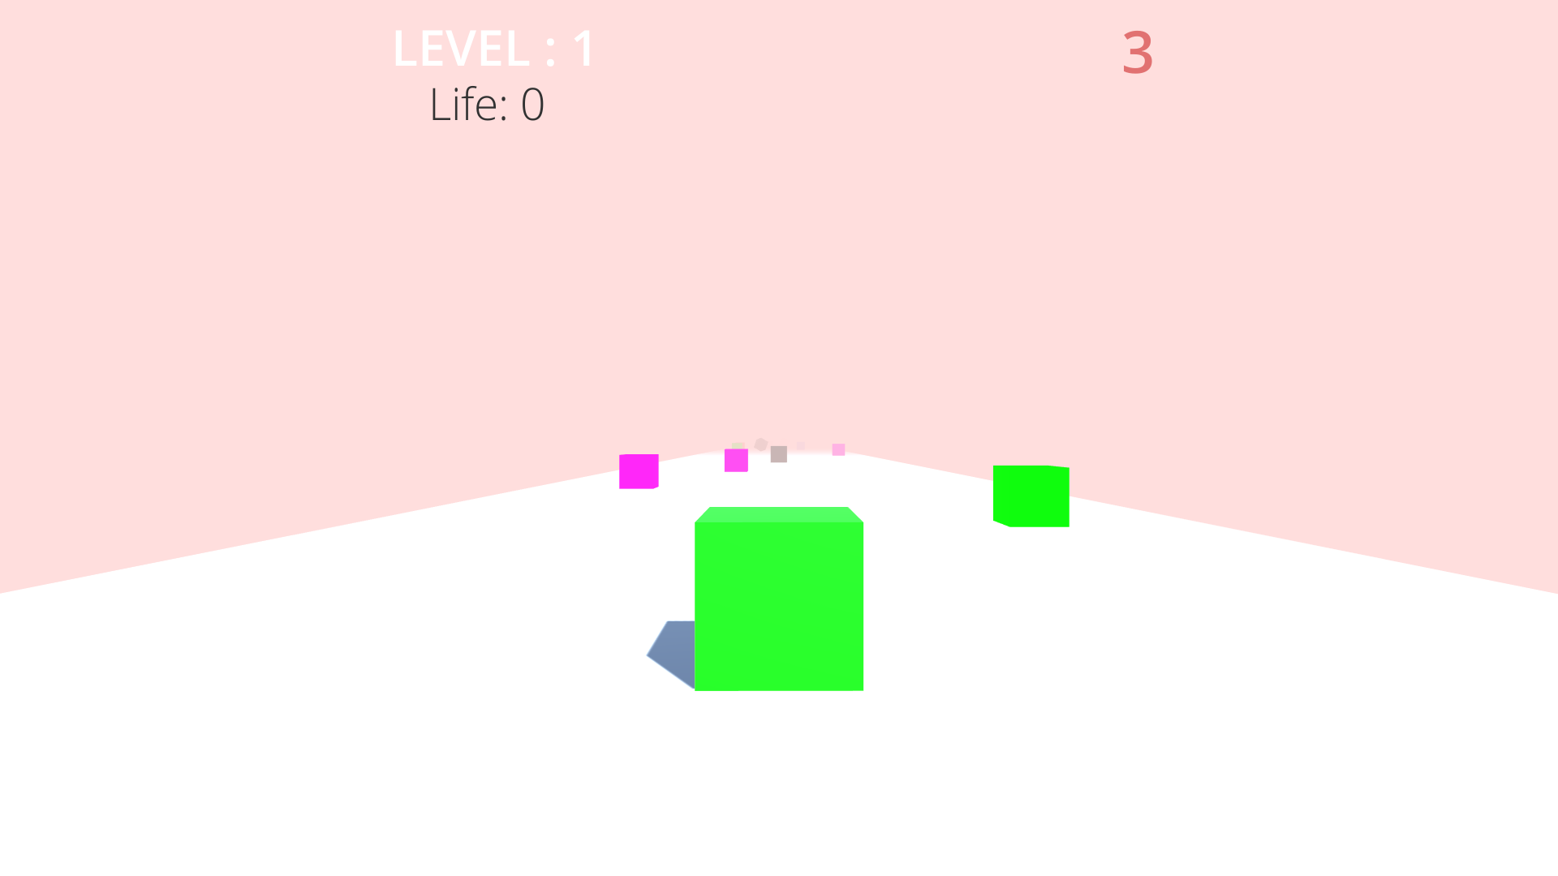
Level 1

Slide 7
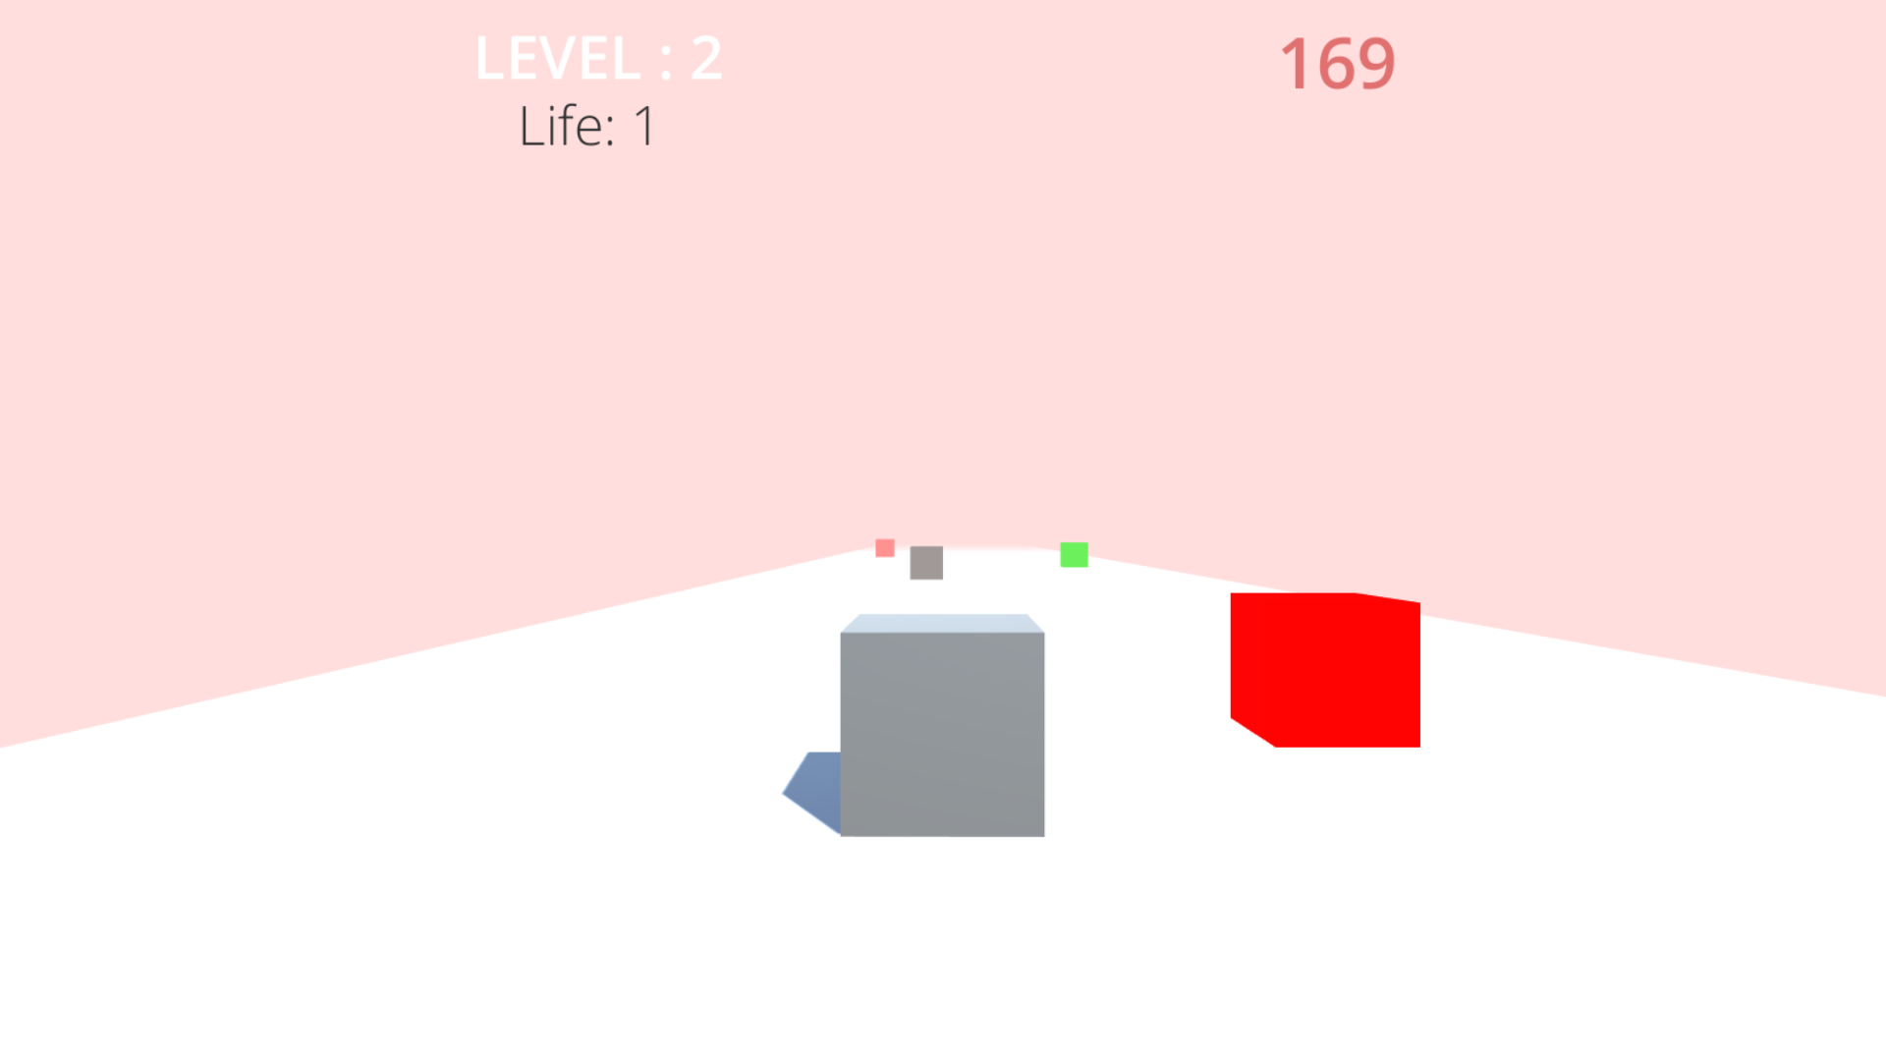
Level 2

Slide 8
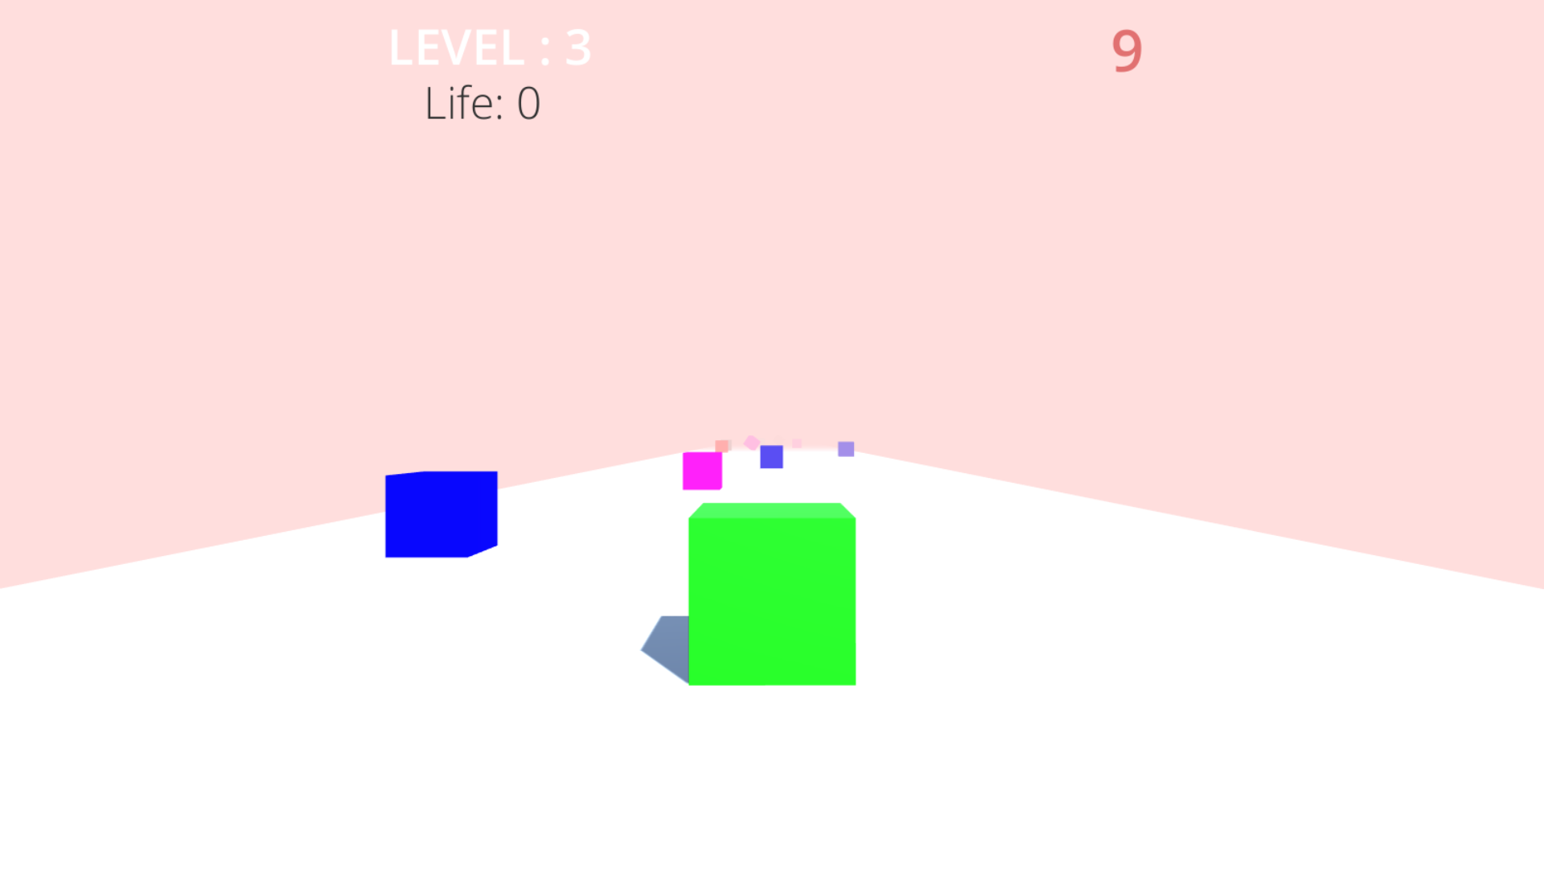
Level 3

Slide 9
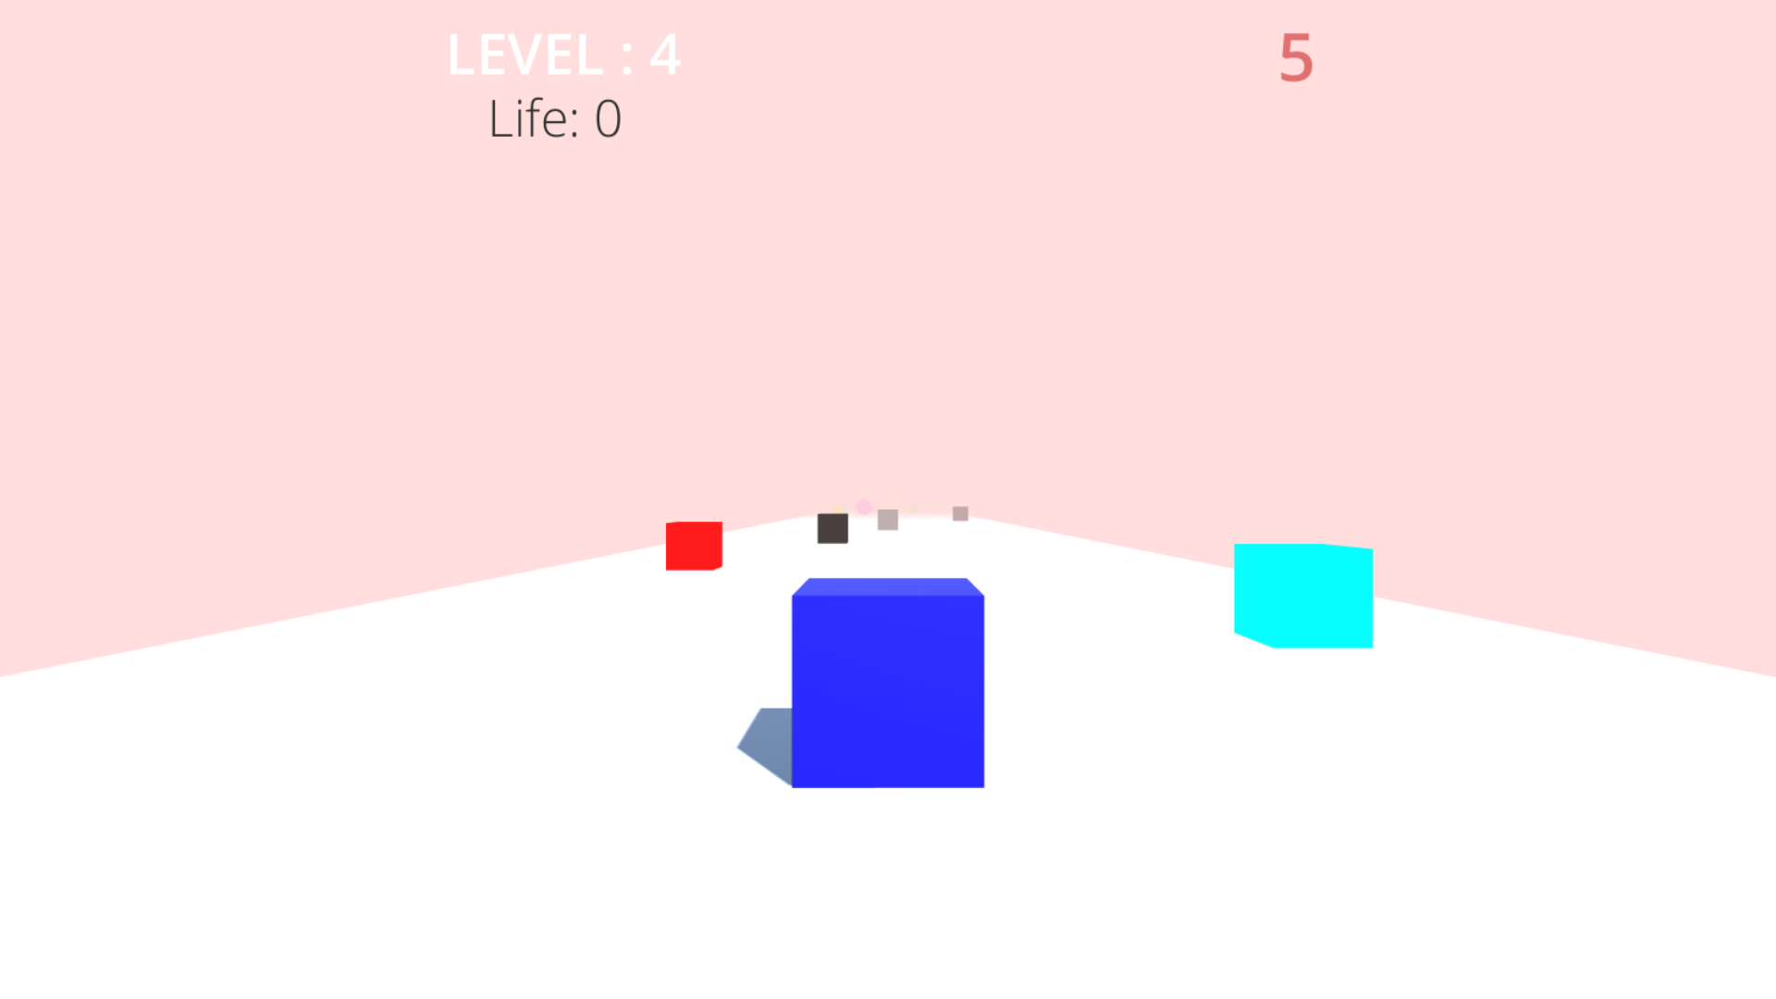
Level 4

Slide 10
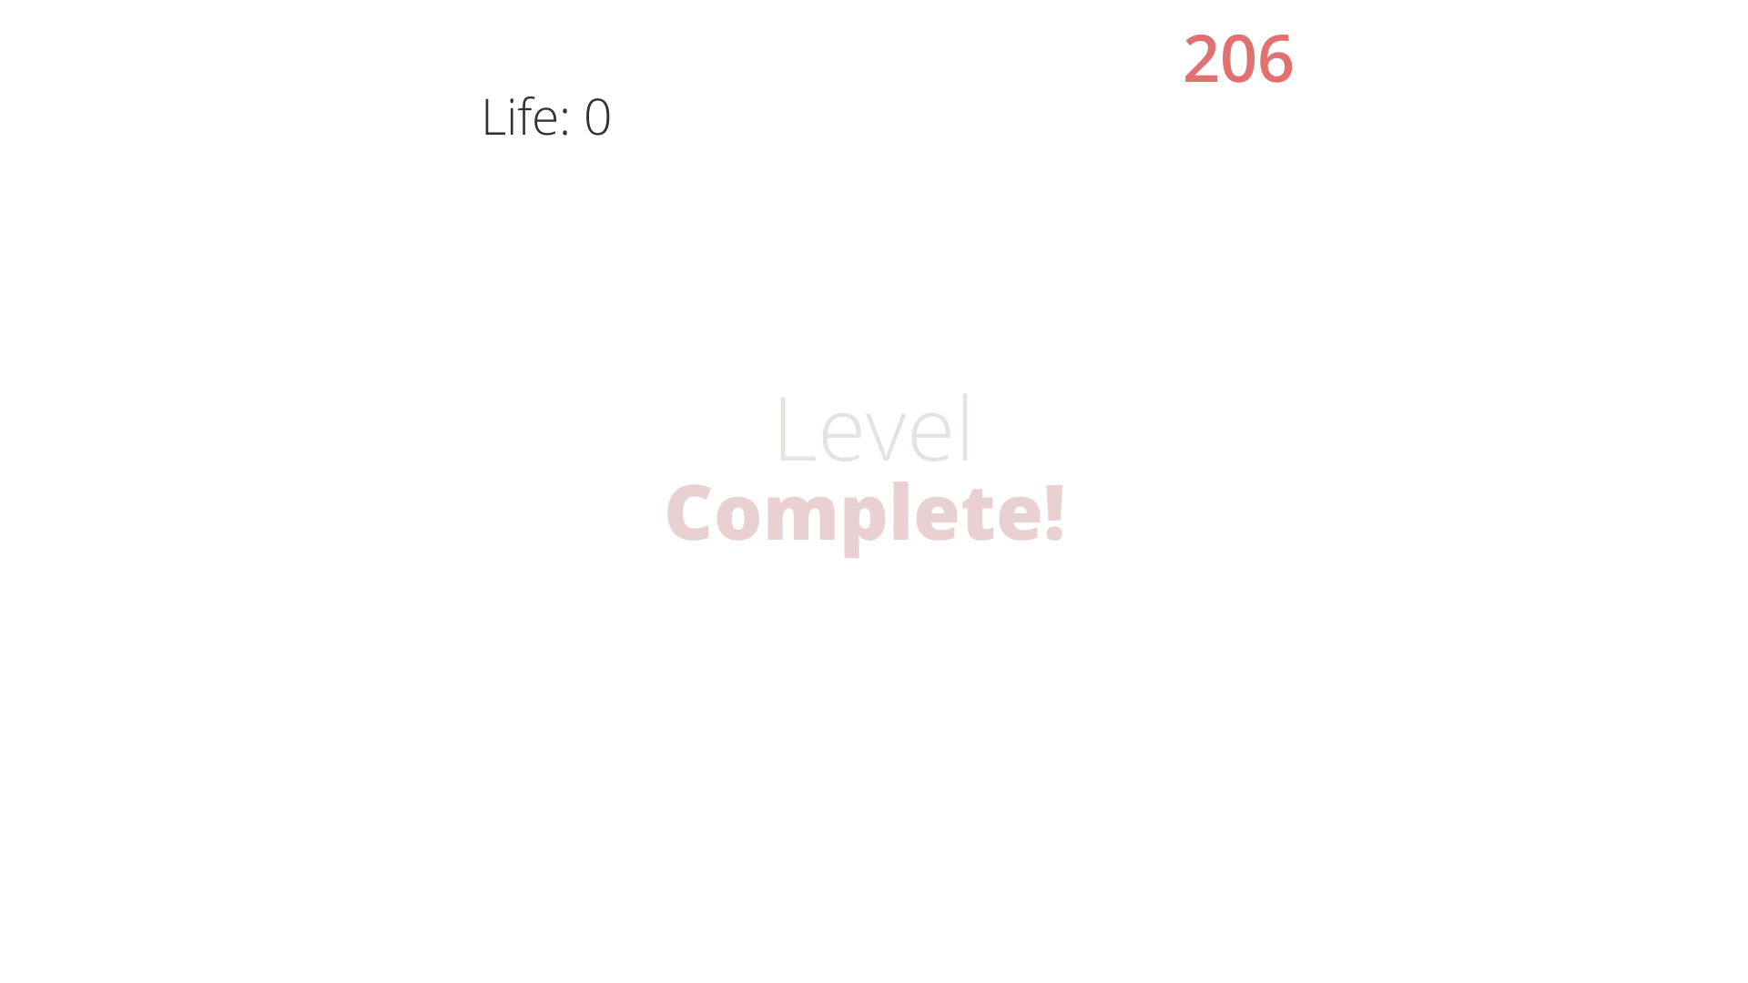
Level Complete UI

Slide 11
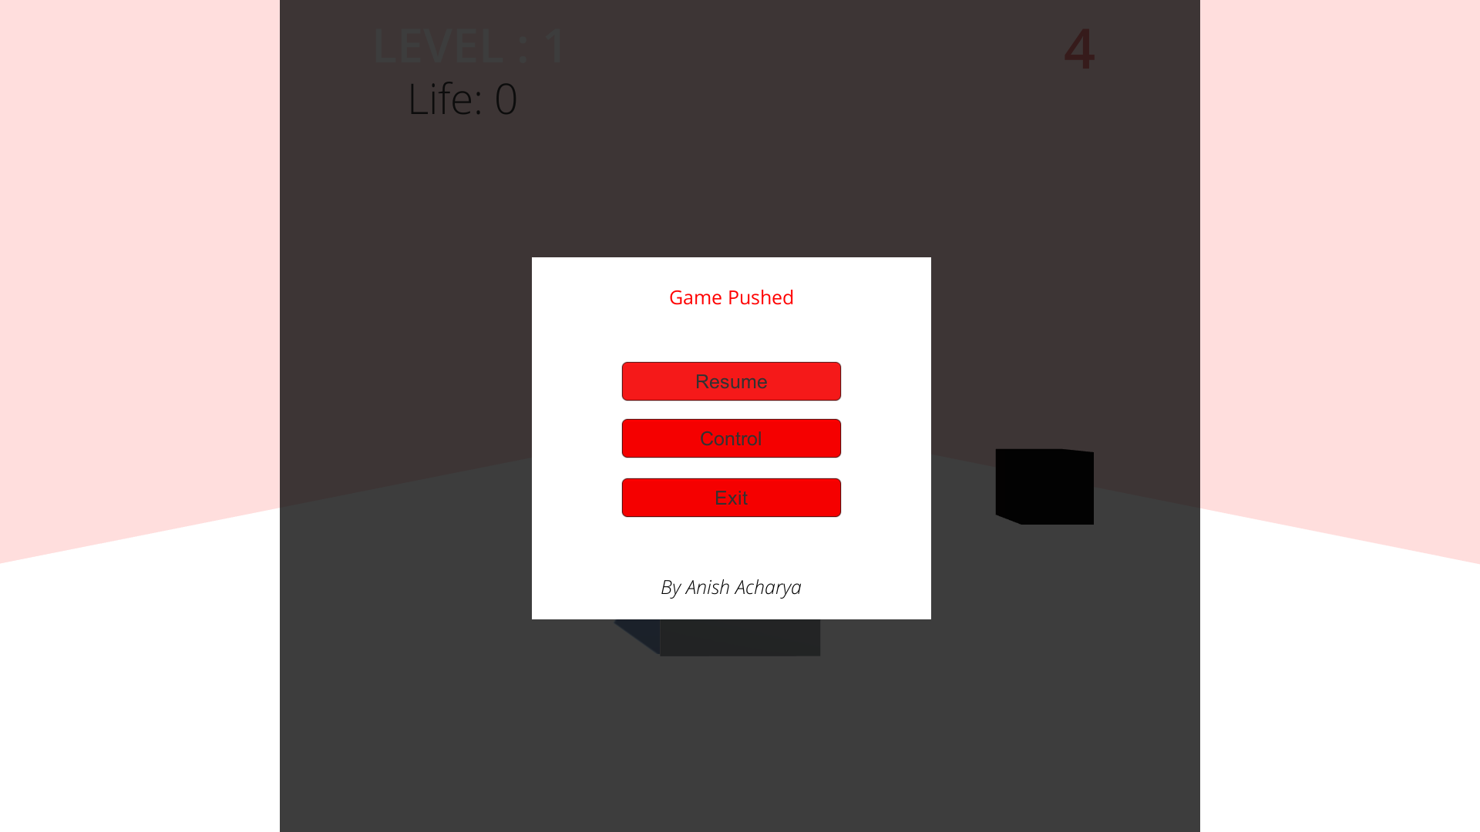
Game Pushed

Slide 12
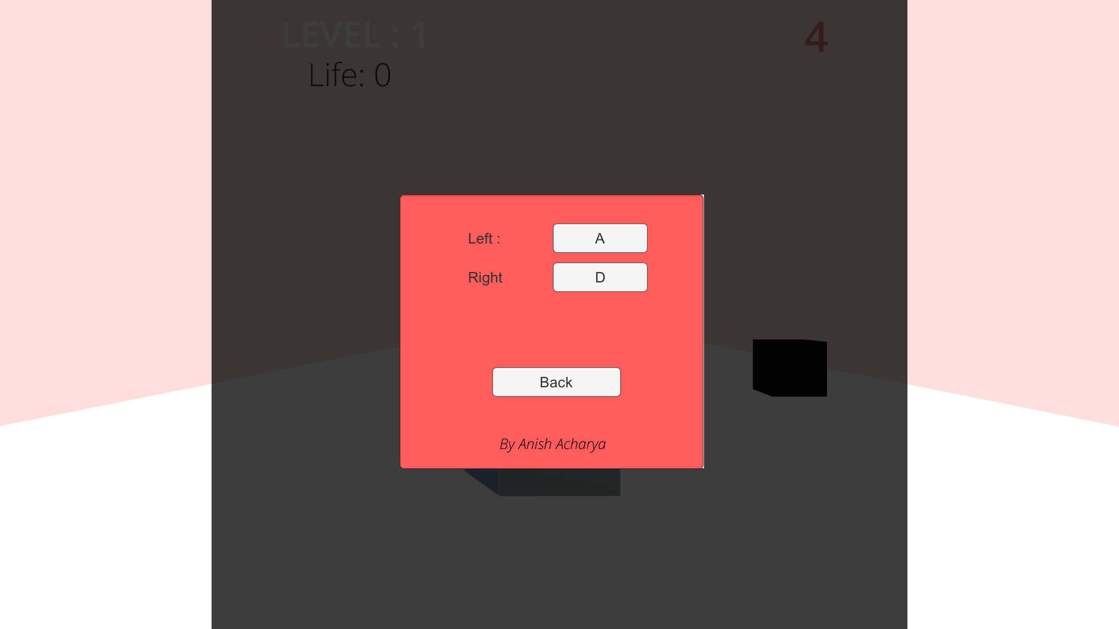
Change Control

Slide 13

Credit Screen

Slide 14
Conclusion
A software project means a lot of experience. In this section we summarize the experience gained by project team during development of “Color Catch”
We learned a lot through this project. This project has sharpened our concept of Game engine, animation and the software-hardware interface.
We learned a lot about different documentation. The piece of software we developed is intended to serve the gamers of the world. The success of this project may give pleasure to billions of game lovers among the universe. This project not only tested our technical skills but also our temperament.
There were times that we almost lost hope but we recovered through constant concentration and hard work.
If any kind of suggestion, improvements, more efficient development idea please feel free to communicate with us.

